Slide 1

Inventory and DEFECT analysis
Ameya Jamgade
Ilia Prokashev

Slide 2
Problem Statement
What drives incidents in the supercharger manufacturing process?

Slide 3
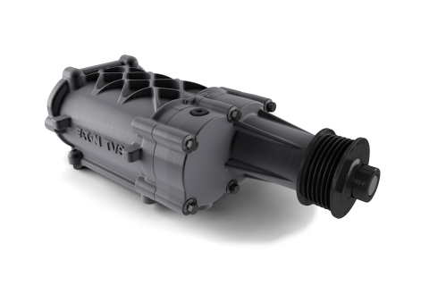
Agenda
Existing Process
Data Collection Sources & Data Manipulation
Analysis of As-Is Process
Discovery
Observations
Recommendations

Slide 4
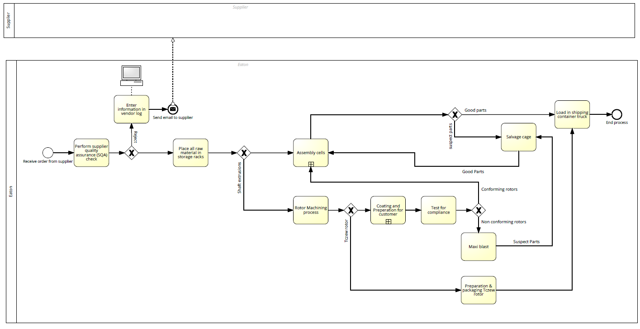
Existing Process

Slide 5
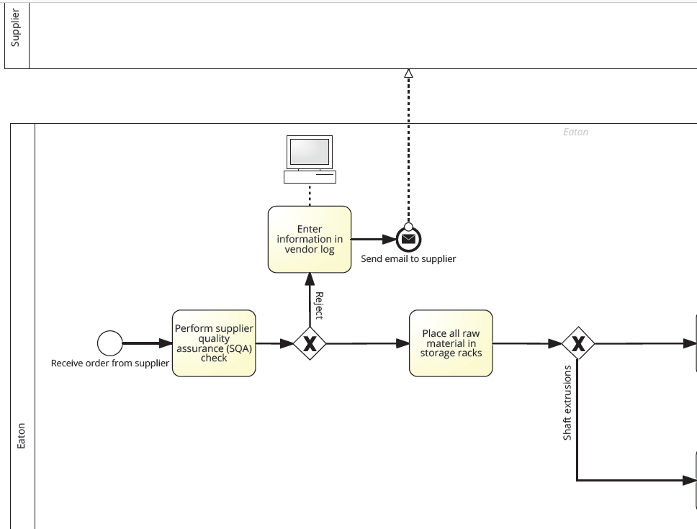

Slide 6
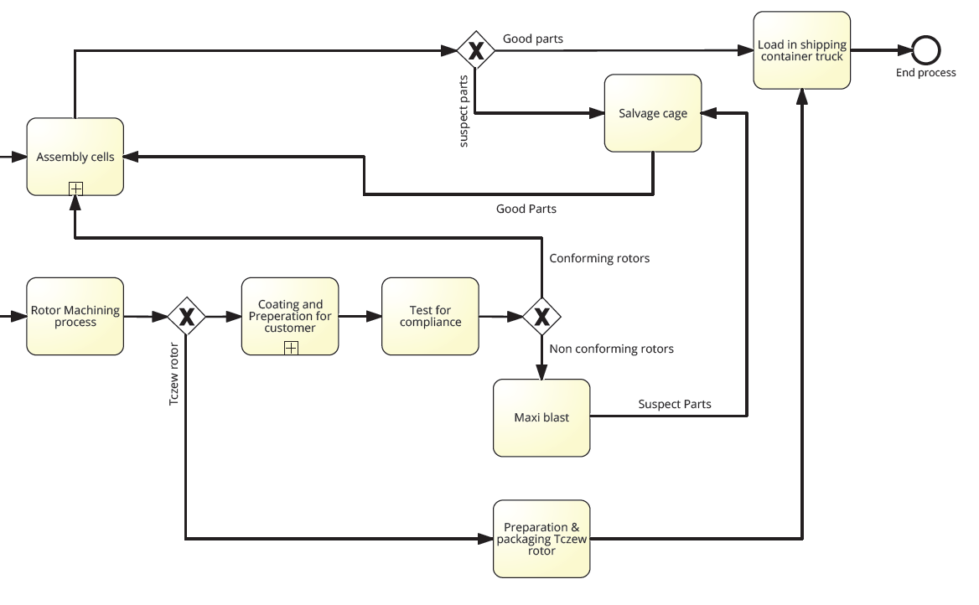

Slide 7
Data Collection Sources
Scrap report
Inventory min/max
Employee Interview

Slide 8
Data Manipulation
Performed Data Wrangling with Trifacta semi-auto data wrangling
Data transformation
Combined data sets from 2 sources
Performed analysis with BigML and Watson Analytics

Slide 9
Analysis of As-Is Process

Slide 12
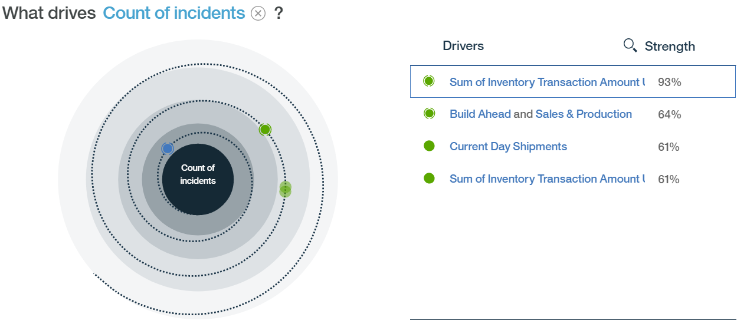
Discovery S&P: Number of Incidents

Slide 13
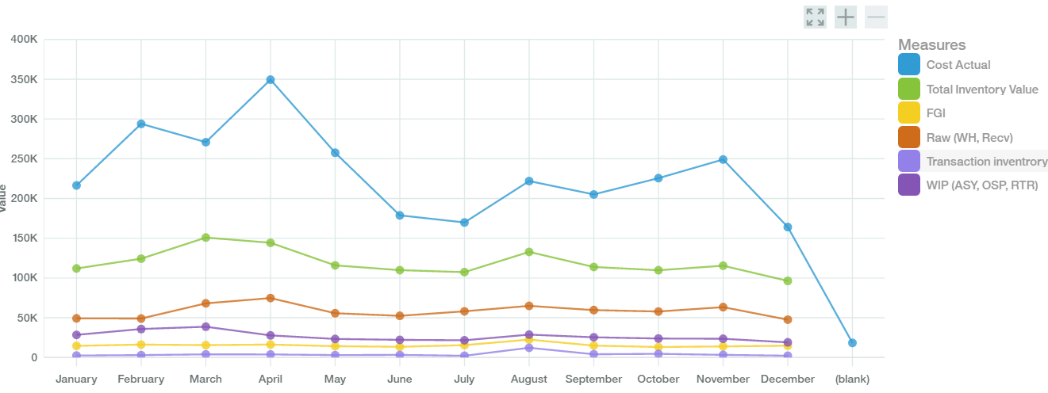
Discovery: Inventory trends

Slide 14
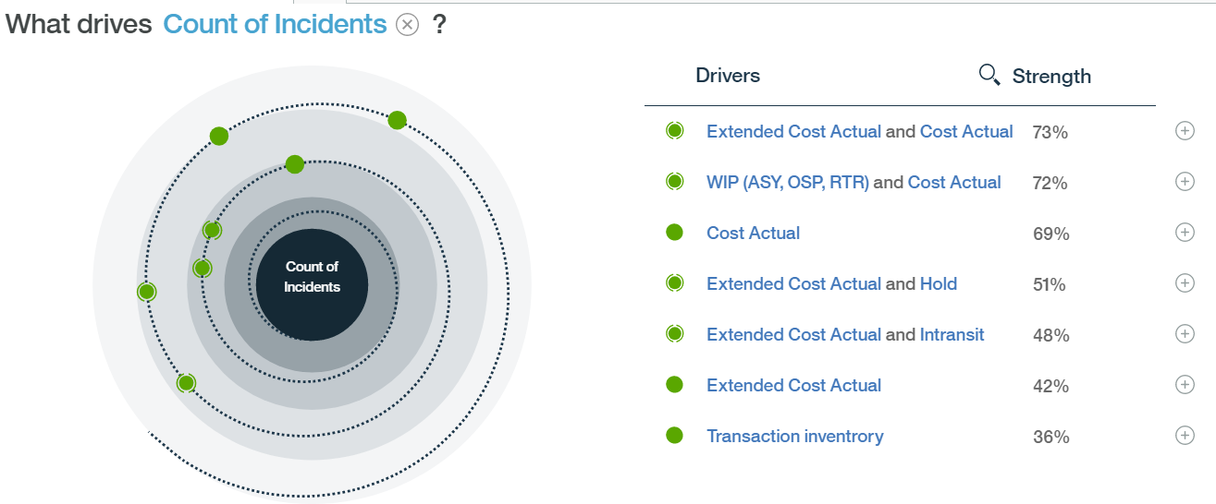
Discovery Inventory: Number of Incidents

Slide 15
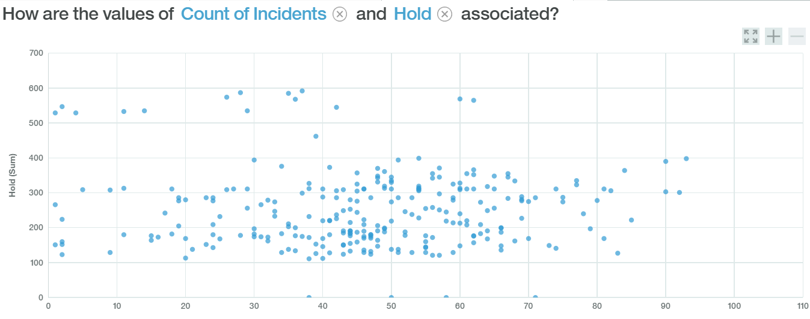
Discovery Inventory: Association between inventory hold & scrap

Slide 16
Observations
Our analysis shows that transaction inventory, units built ahead and Inventory Quantity are main drivers of incident costs.
The same factors along with current day shipment seem to have impact on the number of incidents.
Both the number of incidents and cost of incidents tend to be increasing during the spring and fall periods.

Slide 17
Recommendations
Implement BPM system
Reduce defects
Improve forecasting accuracy

Slide 18
Implement BPM system
Pros
Implementing a robust BPM system would help Eaton document & capture data at each stage of the process.
This data can be analyzed to identify most problematic tasks in the manufacturing process.
Improved Agility and performance visibility.
Complies with Lean6Sigma and Eaton’s best practices
Process reports will help to reduce waste and improve efficiency much faster than with classic ERP systems.
Relatively inexpensive.
Cons
New practice in the US – lack of support from senior leadership.
Capturing data at each stage might prove difficult since multiple raw materials get converted into a single item.

Slide 19
Reduce defects
Utilize data captured in BPM system
Perform extensive root cause analysis
Develop action a plan to engineer-out the causes forever.
Place checks and tests to prevent the defects from entering in future.
Measure performance under through KPI’s to gauge improvement level
Preventive Maintenance
A machine that is obsolete, dirty or otherwise in need of care is one that cannot function properly.
units produced are more likely to be compromised because the machine is not up to par.
Preventive maintenance can spot and fix problems

Slide 20
Improve Forecasting accuracy
Forecast at the right level
Periodically review your current level of forecast and decide whether it is appropriate given the forecast accuracy goals and review process
Identify and correct anomalies before putting the forecast into the inventory planning system.
Measure and report forecast accuracy
Successful forecasting involves constantly measuring the progress via metrics and reporting results to all stakeholders

Slide 21
Improve Forecasting accuracy
Oracle Demand Management software
Pros
Respond to demand variability and uncertainty with real-time demand planning
Improve forecast accuracy with an automated and sophisticated Bayesian forecasting engine
Quickly respond to changing market conditions
Cons
Software implementation would require additional resources
Cost of purchasing licenses, training staff, internal support costs and maintenance costs
Adequate support from senior management to sponsor this project.

Slide 22
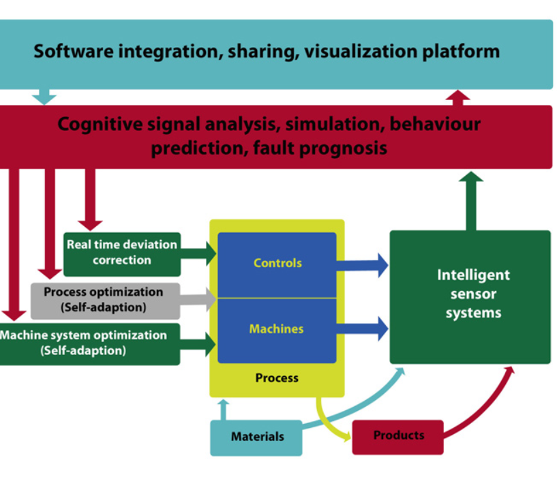
Future of Manufacturing

Slide 23
Thank You

